Slide 1
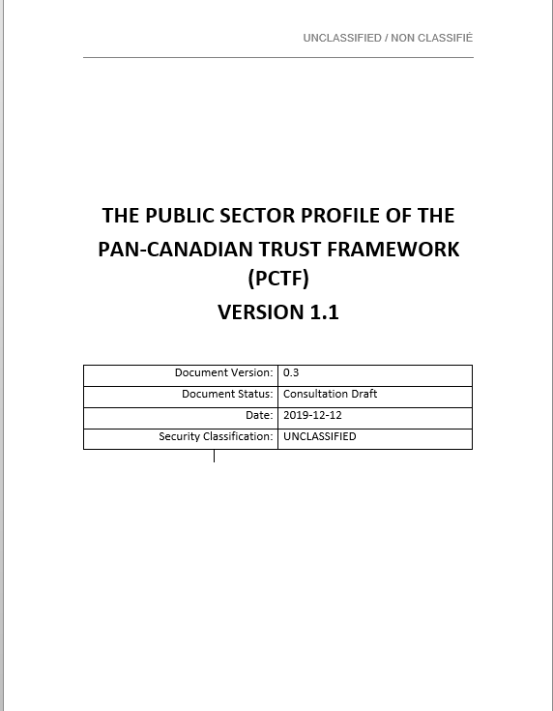

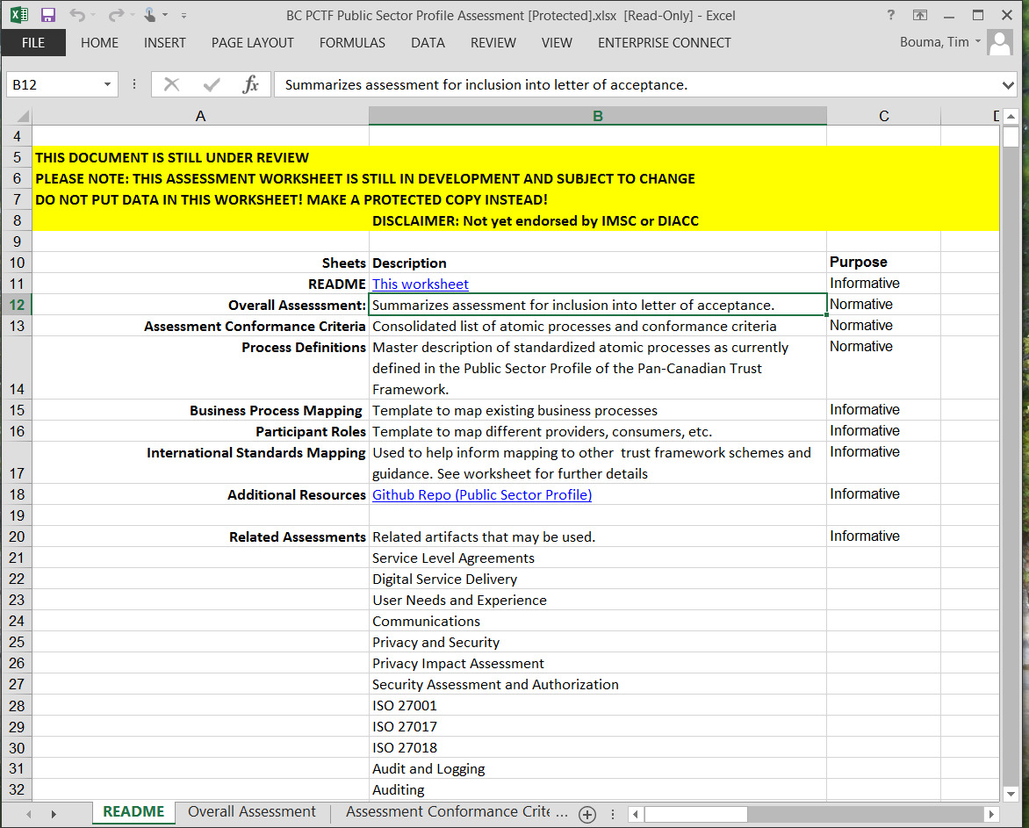


Pan-Canadian Trust Framework Public Sector Profile V1.1
Primary Deliverable
Pan-Canadian Trust Framework Document
Comprehensive document (67 pages)
Combines scope of Persons, Organizations, and Relationships
Defines 25 Atomic Processes and Qualifiers (levels of assurance, etc.)
Provides background information, high-level guidance and definitions.
PCTF Assessment Worksheet
Specifies Conformance Criteria for each atomic process (approximately 250 in total)
Outlines an Overall Assessment Approach to collect and assess evidence (program documentation, etc.)
Documents assessment outcome for each conformance criteria: [Accepted, Not Accepted, Accepted with Condition, Accepted with Observation, Not Applicable]
Letter of Acceptance
Formally documents the outcome of PCTF assessment process
Issued to acknowledge acceptance of a trusted digital identity.
Consultation
Canadian
Public Sector
Trusted Digital Identity
Assessment Worksheet
Letter of Acceptance
Acceptance

Slide 2


Overview of PCTF Public Sector Profile Assessment Process
Assessment process is conducted in four phases over two fiscal quarters
Resourcing during phases requires 3.0 FTE * - 2.0 FTE* for dedicated analysis + part-time 1.0 FTE for consultation and assistance.
Engagement
Program Mapping
Program Assessment
Finalize
Team Formation
Evidence Gathering
Analysis
Process Mapping
Discovery
Peer Review
Consultation & Workshops
Criteria Assessment
Overall
Assessment
Kick-off
Letter of Acceptance
Site Visit (If Possible)
Approval Process
Start
Q1
Q2
Estimated Duration: 2 fiscal quarters (approximately 6 months)
Estimated Effort: Q1: (2.0 FTE x 100% + 4.0 FTE x 25% = 3.0 FTE) Q2:(2.0 FTE x 100%+ 10.0 FTE x 10% = 3.0 FTE )
* FTE is full-time-equivalent

Slide 3


PCTF Public Sector Profile Assessments: Conducted to Date
Province of Alberta
April-August 2018 Initial Assessment
September 2018: Letter of Acceptance Issued
August 2019: Go-Live on My Service Canada Account
January 2019: Quarterly Review
Province of British Columbia
August-December 2019 Initial Assessment
Q1 2020: Letter of Acceptance Issued (Est.)
Q1 2020: Go-Live on My Service Canada Account and My CRA Login (Est.)
Q2 2020: Quarterly Review (Est.)
Rest of Canada
2020-202X (Est.)

Slide 4
PCTF Public Sector Profile: Key Milestones and Next Steps
Pan-Canadian Trust Framework Consultation Draft Version 1.1
PCTF Working Group Consultation Draft was finalized on February 13th, 2020
Planned release on GitHub for broader consultation and review (March 2020).
Seeking IMSC endorsement at next meeting on April 1^{st,} 2020
PCTF Assessment Worksheet
Consolidation all Conformance Criteria for each atomic process (approximately 250 in total)
Integration of Verified Organization Conformance Criteria (may be a separate worksheet)
Continued refinement and validation of Conformance Criteria
PCTF Assessment and Mutual Recognition
Continued iteration of PTCF assessment processes into a a formalized program.
Exploring alignment with other frameworks (eIDAS, Digital Nations, etc.)

Slide 5
PCTF Public Sector Profile: Lessons Learned
Requires collaborative team effort with experts on the ground.
Kick-off involved in-person visit to i) gain direct knowledge of program and ii) establish close working relationship between team members.
Regular calls (and videoconferencing) between teams.
Gathered and compiled evidence using conformance criteria templates submitted for assessment.
Assessment is a discrete work stream, however tightly coupled to other work streams (technical integration, MOU, agreements etc.)
Engage legal counsel early in the process, as there will be implications for agreements and authorities.
Assessment process is iterative and continuously improving.
Applying best practices from other frameworks (e.g., security assessment and authorization)
Development of master spreadsheet to assess evidence against conformance criteria with traceability to policy requirements.
Evidence collected in separate documents and filed for subsequent analysis, review and audit. Final review results in a Letter of Acceptance.
Next Steps: PCTF is evolving for fit and purpose (we are defining the ‘state of the art’)
Continue to clarify distinction of responsibilities between departments and jurisdictions. Identifying dependences with processes in existing programs (e.g. vital statistics, motor vehicle licensing) and other jurisdictions (e.g., federal immigration).
Maintain focus of PCTF as a business process integrity framework that complements (not replaces) existing technical interoperability standards and frameworks (e.g., SAML, Open ID Connect, Verifiable Credentials). PCTF also complements existing assessment processes or agreements (e.g., Privacy Impact Assessment, Security Assessment and Authorization, SOC2 Trust Principles).
Ensure PCTF is alignment with global frameworks, World Bank, European Union, Financial Action Task Force (customer due diligence)

